Slide 1
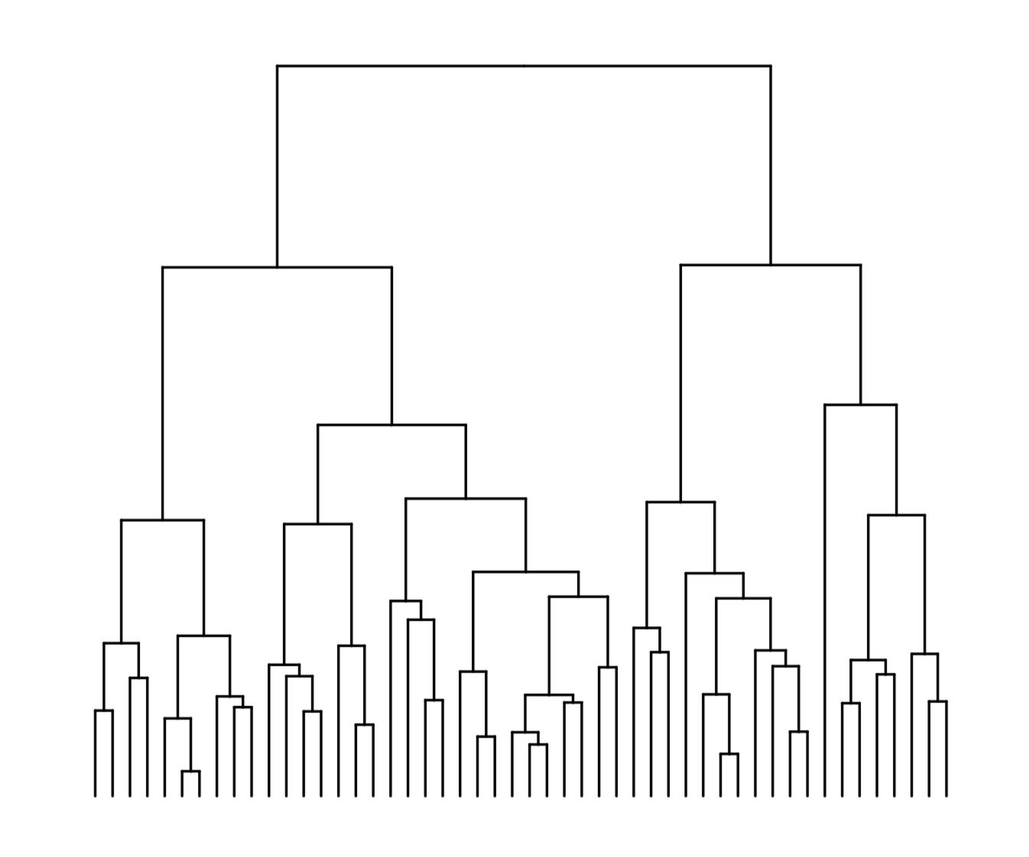
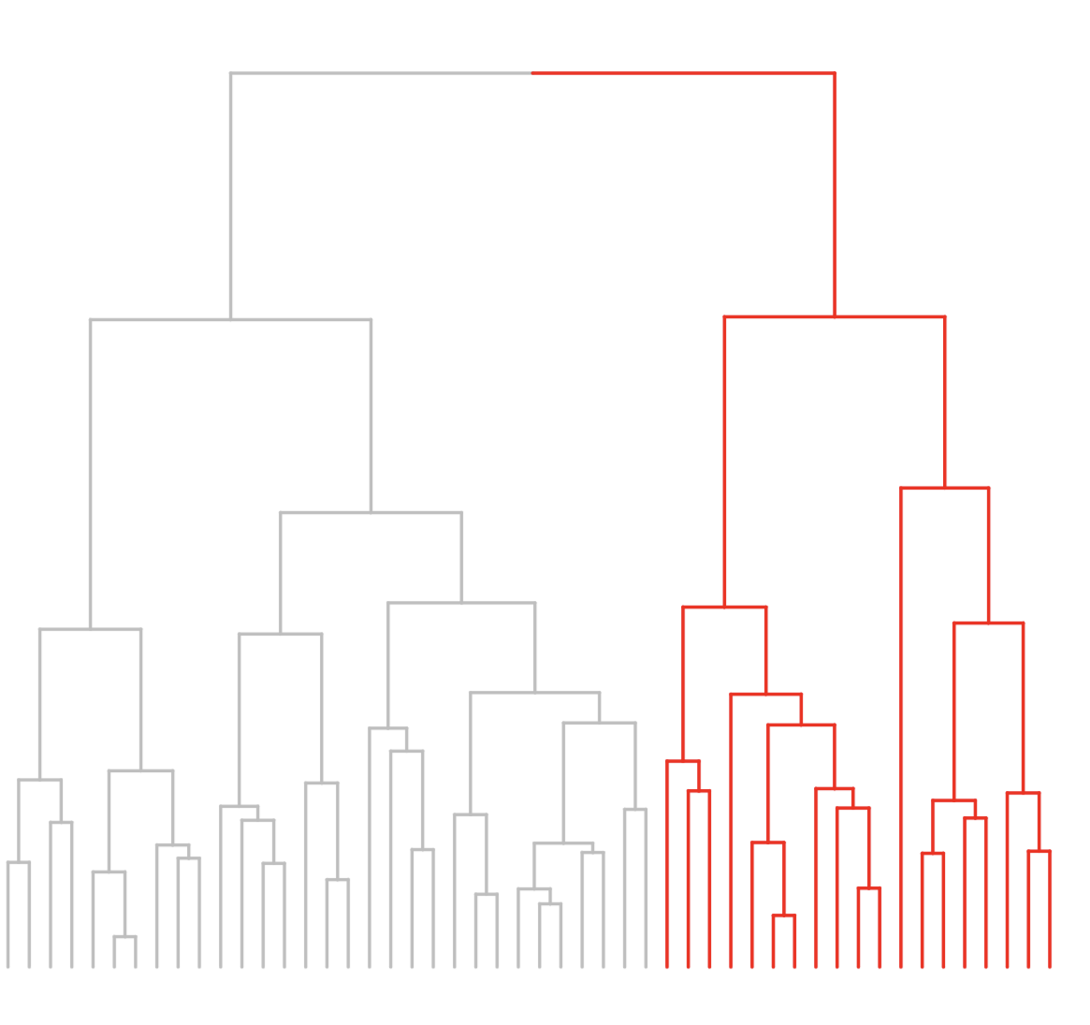
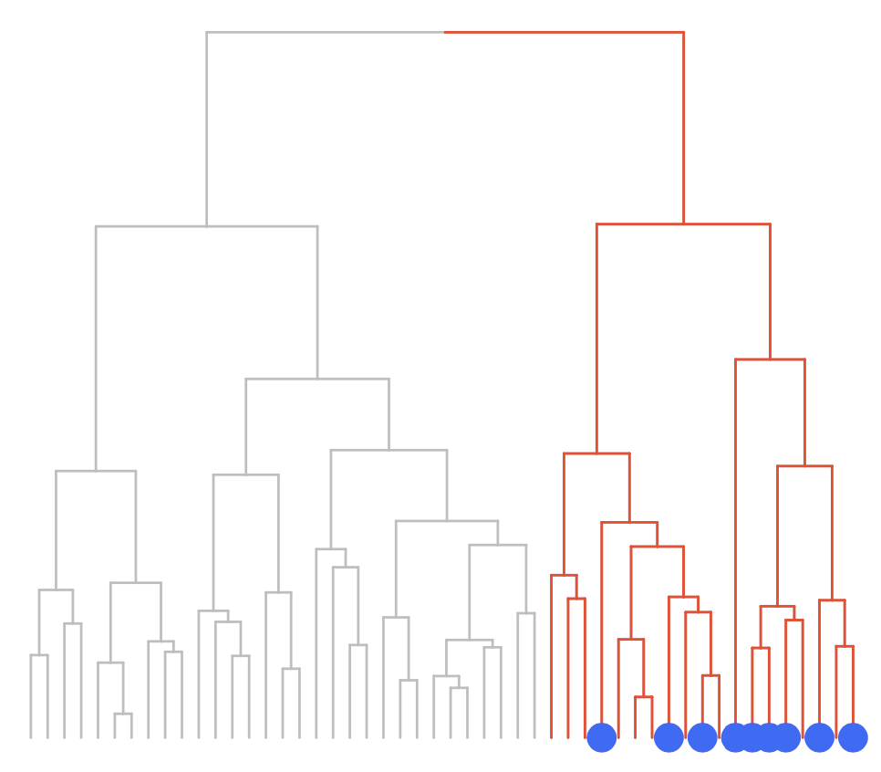
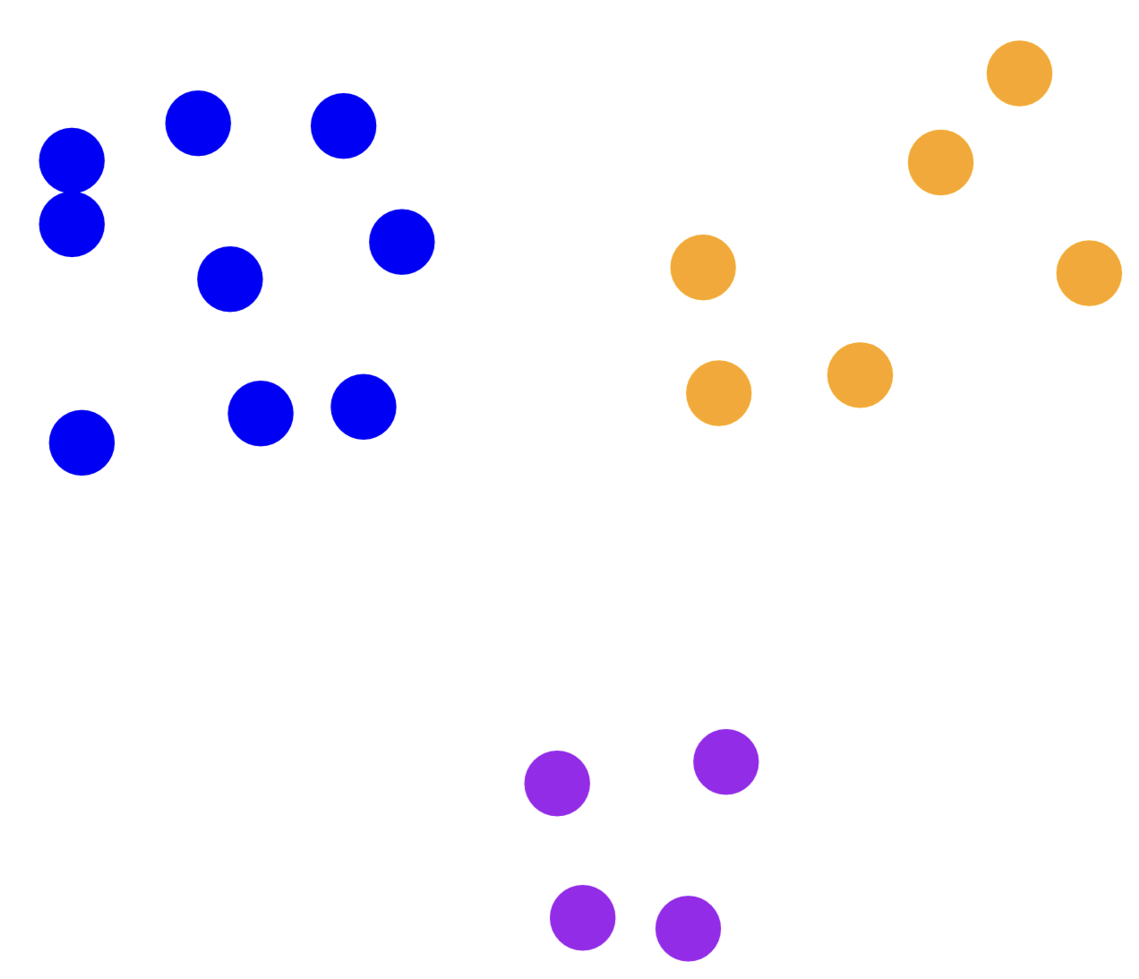
Clustered distance metric
Sample branch
Repeat per cluster
Sample leaves
Figure 1

Slide 2
A
B
Figure 2

Slide 3
A
B
C
Figure 3

